Slide 1
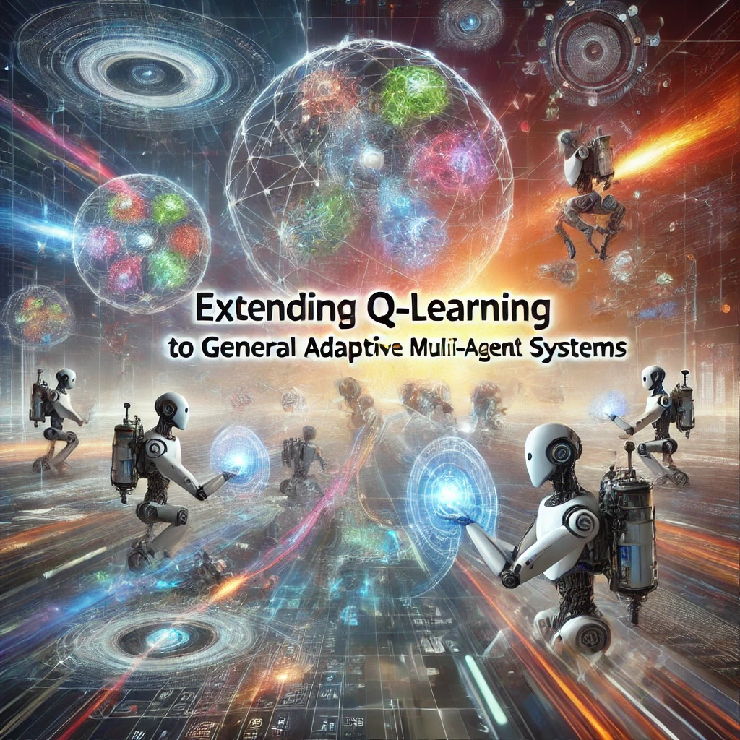
Gerald Tesauro | IBM Research

Slide 2
Problem with Q Learning
(a) they learn deterministic policies, whereas mixed strategies are generally needed;
Example: In the game of Rock-Paper-Scissors, a deterministic strategy (always choosing rock, for example) can be easily exploited by an opponent. However, a mixed strategy (choosing rock, paper, or scissors randomly with equal probability, 1/3 each) is more robust as it doesn't provide a consistent pattern for the opponent to exploit.
(b) the environment is generally non-stationary due to adaptation of other agents.
Example:

Slide 3

Example
Imagine an online auction system where multiple bidders (agents) are competing to win items. Each bidder can see the bids (actions) of other participants but cannot see their internal valuations or motivations (payoffs). The bidders use different algorithms to decide their bidding strategy, which are not known to the others (the forms of their learning algorithms are unknown).
Over time, as the auction progresses, each bidder may adapt their strategy based on the observed actions of others. For instance, if a bidder notices that another consistently increases their bid by a small amount just before the auction closes, they might start placing their final bid slightly higher than before to outbid them. This adaptation leads to a non-stationary environment where strategies evolve and are not constant over time.

Slide 4
Example
To navigate this complex scenario, a bidder might use an estimation approach to predict future bids of competitors based on their past bidding patterns, rather than relying solely on traditional game-theoretic predictions which assume rational and static strategies. For instance, using a machine learning model, a bidder could predict when and by how much a competitor might increase their bid, based on past behavior, and adjust their strategy accordingly.
This dynamic interplay, where strategies are continually adapted based on observations rather than fixed game-theoretic expectations, makes the auction environment a practical example of a repeated stochastic game as described in your article.

Slide 5
This Article Assumptions
The multi-agent environment is modeled as a stochastic game in which other agents’ actions are observable, but not their rewards.
Other agents are assumed to learn, but the forms of their learning algorithms are unknown and their strategies may be asymptotically non-stationary.
During learning, it is proposed to estimate other agents’ current strategies from observation instead of game-theoretic analysis.

Slide 6
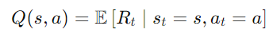
Q Learning
Definition: A reinforcement learning technique used to find the optimal action-selection policy in a Markov Decision Process (MDP).
Process Overview
Observe State (s): Agent observes the current state.
Choose Action (a): Agent selects a legal action based on current policy.
Receive Reward (r) and Transition: Agent receives an immediate reward and moves to a new state (s′).
Q-Learning Equation
:
Variables:
γ: Discount factor that balances immediate and future rewards.
α(t): Learning rate, adjusts the weight given to new information over time.

Slide 7
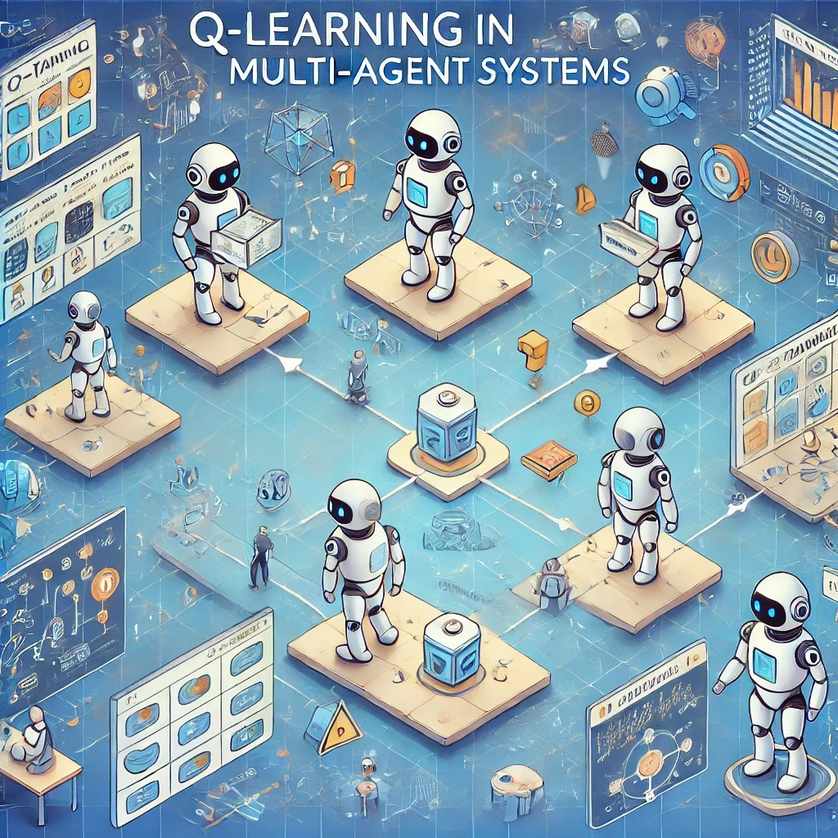
Q Learning
Convergence Guarantee
Optimal Value Function (Q):* Q-learning is guaranteed to converge to the optimal value function if a suitable exploration method is used.
Optimal Policy (π):* The greedy policy associated with Q* is optimal, guiding decisions at each state.

Slide 8
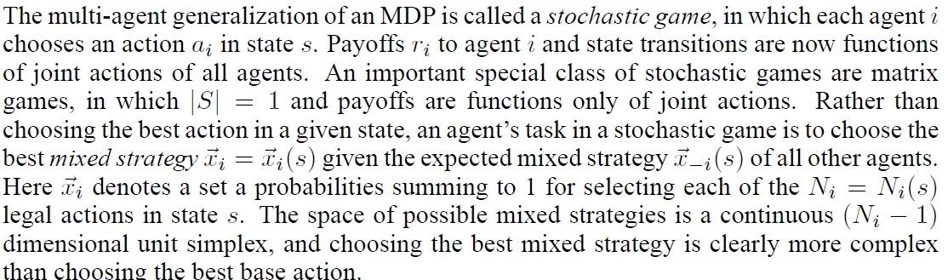
Stochastic Games in Multi-Agent Systems
Definition: An extension of Markov Decision Processes (MDPs) tailored for environments involving multiple agents.
Key Characteristic: Each agent's payoffs and state transitions depend on the joint actions of all agents involved.

Slide 9
Multi-agent generalization of an MDP (Markov Decision Process):
This refers to extending the concept of an MDP to scenarios where multiple agents are involved, each making decisions.
Stochastic game:
A type of game where multiple agents choose actions in a probabilistic environment. The outcomes depend on the combination of actions chosen by all agents.
Action a_i:
The action chosen by agent i in a given state s.
Payoffs r_i​:
The rewards or payoffs received by agent iii based on the actions taken by all agents and the resulting state transitions.
State s:
The current situation or configuration in which the agents find themselves, which may change based on their actions.
Matrix games:
A specific class of stochastic games where there is only one state (∣S∣=1), and the payoffs depend only on the joint actions of the agents.
Mixed strategy x_i:
A probabilistic approach where agent iii assigns probabilities to each possible action instead of choosing a single action. The probabilities sum to 1.
Expected mixed strategy x_−i(s):
The expected mixed strategies of all other agents (i.e., not including agent i) in state s.
Legal actions Ni=Ni(s):
The set of valid actions that agent i can take in state s.
Continuous (Ni−1)-dimensional unit simplex:
There are N possible actions. There for the N_i-1 Unit simplex for the possibilities to choose each action.
A unit simplex in (Ni−1)-dimensional space is a generalization of a triangle (2-simplex) or a tetrahedron (3-simplex). It is a geometric figure where each vertex represents a pure strategy (100% probability on one action and 0% on others), and any point inside the simplex represents a mixed strategy (a combination of actions with certain probabilities). The sum of the probabilities is constrained to equal 1, which defines the simplex.

Slide 10
Hyper-Q Learning Algorithm
ΔQ(s, y, x): Represents the change in the estimated Q-value for a given state s, opponent strategy y, and agent's strategy x.
α(t): The learning rate at time t. This is a factor that determines how much new information affects the existing Q-value. Typically, it decreases over time as the agent learns more about the environment.
r: The reward received after taking an action based on strategy x in state s and given the strategy y of the opponent.
γ (gamma): The discount factor. This value dictates the importance of future rewards. A value close to 0 makes the agent short-sighted by considering only immediate rewards, while a value close to 1 makes it far-sighted by considering long-term rewards more significantly.
Max x’ Q(s', y', x'): The maximum Q-value achievable for the next state s′, considering the potential future opponent strategy y′ and all possible strategies x′ the agent might take. This term is crucial for planning by estimating the future benefit of the best possible decision made in the next state.
Q(s, y, x): The current Q-value for the state s with the opponent's strategy y and the agent's strategy x. This value estimates the expected long-term reward for taking action x in state sss while the opponent uses strategy y.

Slide 11
Function Approximation
Due to the continuous nature of mixed strategies in Hyper-Q, it is impractical or impossible to maintain a table of all possible state-action pairs (as done in traditional Q-learning with a Q-table). Hence, function approximation methods are used to estimate the Q-values.
Function Approximation: Techniques such as neural networks, linear regression, or other forms of machine learning models that predict Q-values based on input features (states and actions) without explicitly storing values for every state-action pair.

Slide 12
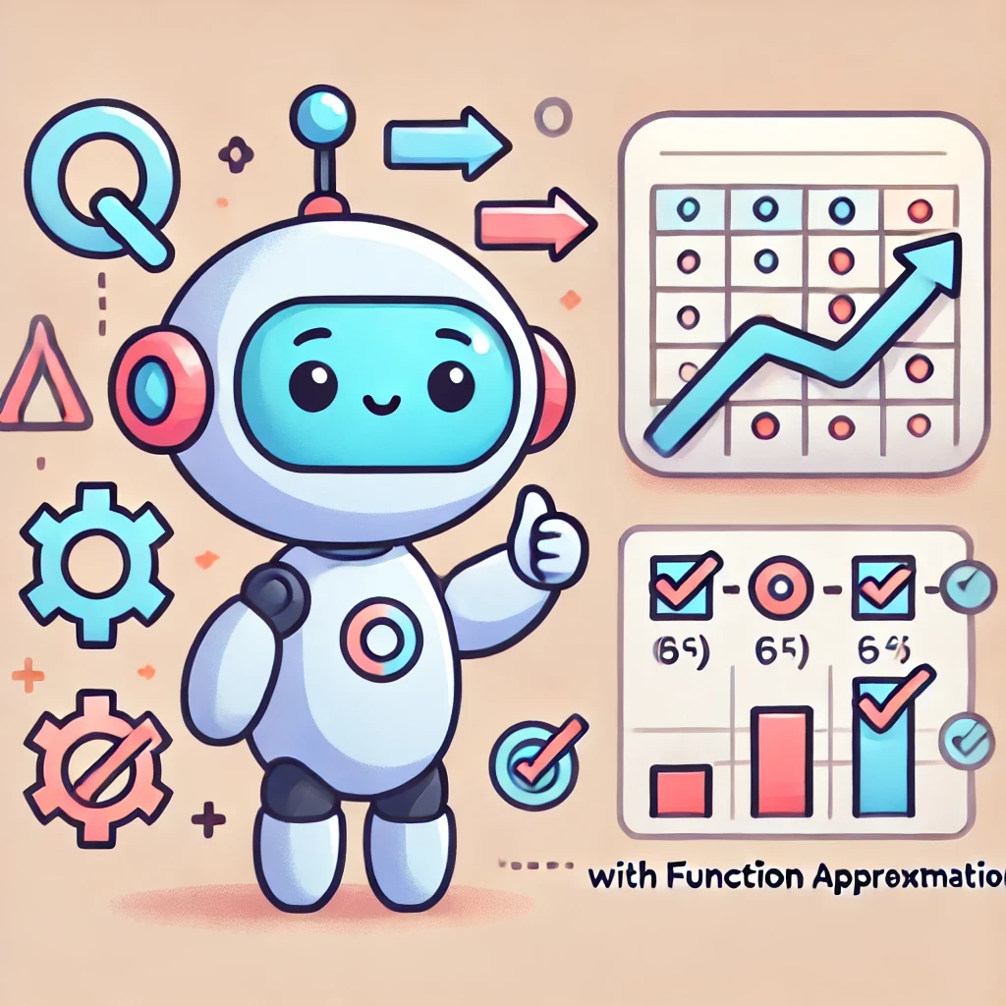
Challenges with Convergence
Establishing convergence—that is, ensuring that the learning process leads to a stable solution where the Q-values do not change significantly with further training—becomes more challenging with function approximation.
Traditional Q-learning with a discrete Q-table can systematically explore and update every state-action pair, eventually converging to the optimal Q-values as guaranteed by the theory under certain conditions.
When function approximation is used, the updates may affect Q-values for a broad set of state-action pairs due to the generalized nature of the approximation, leading to potential stability and convergence issues.

Slide 13
Loss of Markov Property with Finite Discretization
Finite Discretization: To manage continuous spaces in practical applications, these spaces are often discretized into a finite set of states or actions. This approach simplifies the problem but can introduce approximation errors.
Markov Property: A key property of Markov Decision Processes (MDPs) where the future state depends only on the current state and action, not on the sequence of events that preceded it.
When you discretize a continuous space, the precision of capturing the true dynamics of the environment can be lost. This loss can mean that the transition between states no longer strictly adheres to the Markov property, potentially making the environment partially observable or introducing dependencies on past states, which complicates the learning process and further challenges convergence.

Slide 14
These complexities highlight why advanced techniques like Hyper-Q need robust and carefully designed function approximation methods to effectively learn optimal strategies in environments characterized by continuous actions and strategic interactions among multiple agents.
This paper employs a simple uniform grid discretization of the mixed strategies of the Hyper-Q agent and its opponents. No attempt will be made to prove convergence under this scheme.

Slide 15
Uniform Grid Discretization Example
Continuous Strategy Space
In the continuous version of the game:
Each player can choose to bet any amount from $0 to $100, potentially with any number of decimal places (e.g., $23.47, $50.01, etc.).
Applying Simple Uniform Grid Discretization
To simplify the learning and decision-making process using Hyper-Q learning:
We discretize the betting range into 10 uniform intervals, each representing a bet of $10 increments. The possible bets now become $0, $10, $20, ..., $100.

Slide 16
Opponent Strategy Dynamics in Hyper-Q Learning
Opponent strategies in stochastic games can follow various dynamical rules, impacting the convergence of Hyper-Q learning.
Stationary Strategies:
Definition: Opponent strategies remain constant over time.
Equation: y(s)=constant
History-Independent Dynamics:
Definition: When the opponent can accurately estimate the Hyper-Q strategy x, and then adapts its strategy using a fixed history-independent rule. This can occur if players are required to announce their mixed strategies, or if the Hyper-Q player voluntarily announces its strategy.
Equation: yt+1=f(s,y(t),x(t))
Complex Adaptive Systems: Typically involves a learning component that adjusts based on past interactions.

Slide 17
Opponent Strategy Dynamics in Hyper-Q Learning
Opponent strategies in stochastic games can follow various dynamical rules, impacting the convergence of Hyper-Q learning.
History-Independent Dynamics:
Definition: Strategies evolve based on a fixed, independent rule unrelated to the agent’s actions. This is a reasonable approximation for many-player games in which any individual has negligible “market impact,”
Equation: y(t+1)=f(s,y(t))

Slide 18
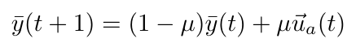
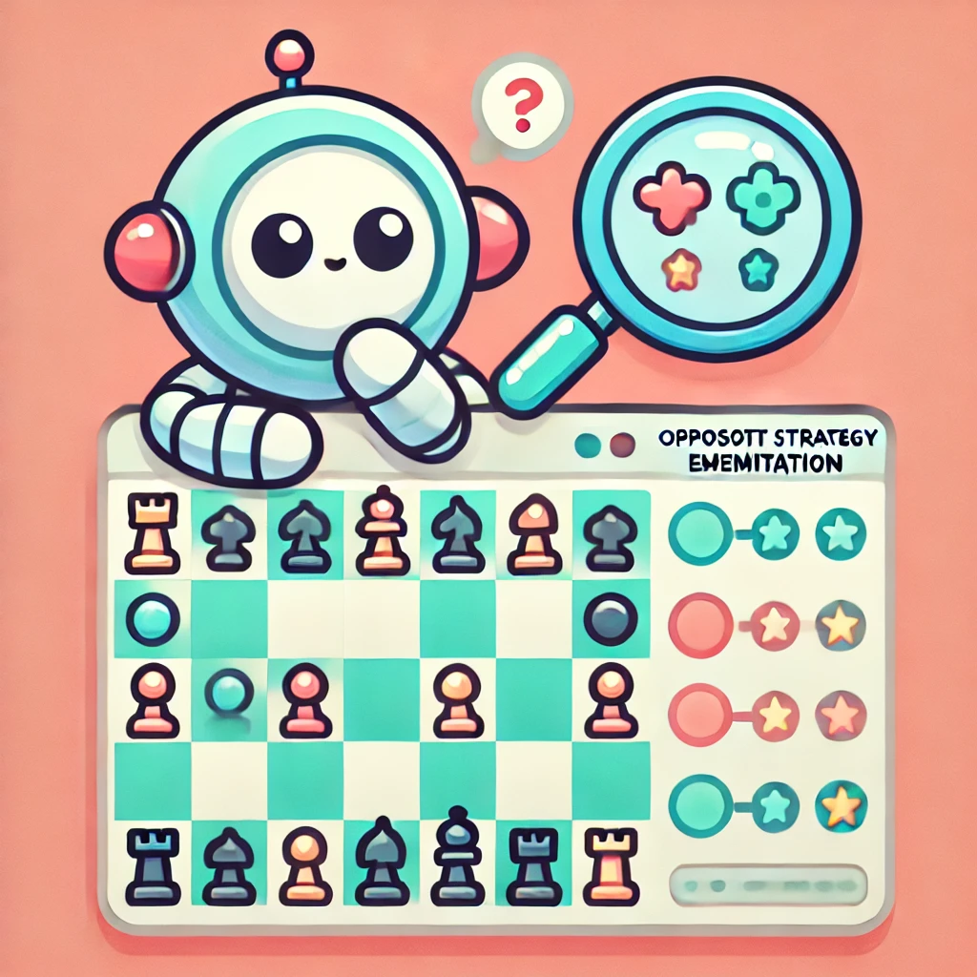
Opponent strategy estimation
Model-Based
consider a class of explicit dynamical models of opponent strategy, and choose the model that best fits the observed data
EMA
Bayesian strategy estimation

Slide 19
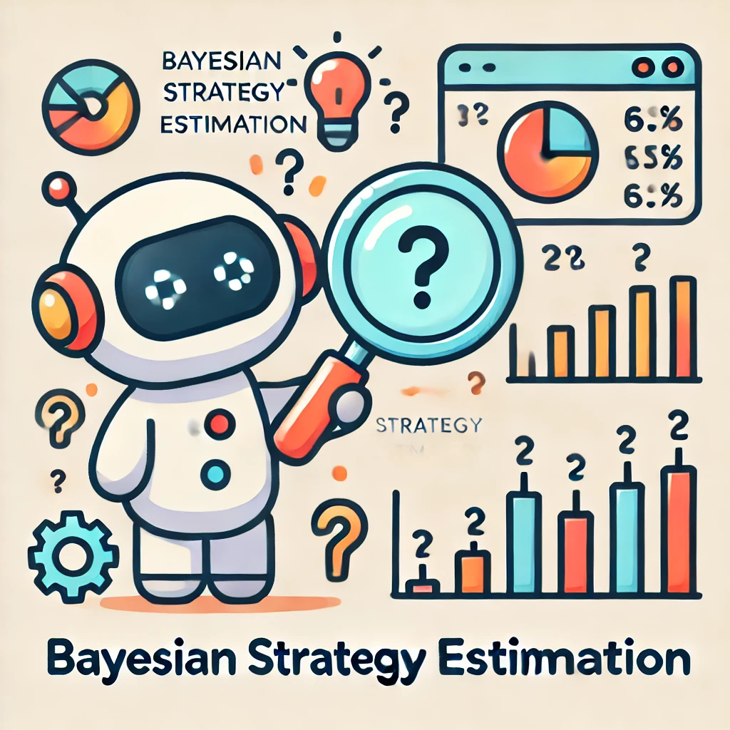
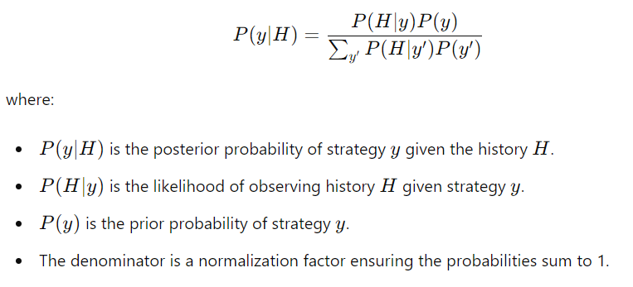
Bayesian strategy estimation

Slide 20
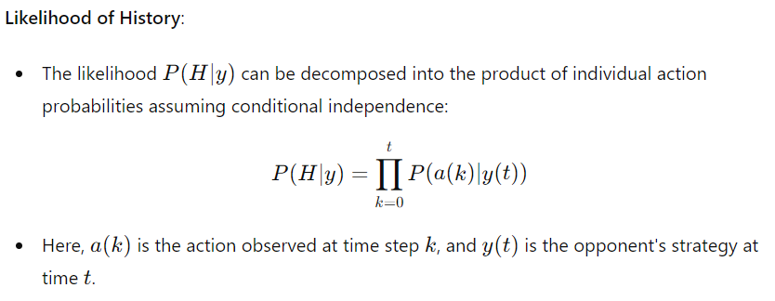
Bayesian strategy estimation

Slide 21
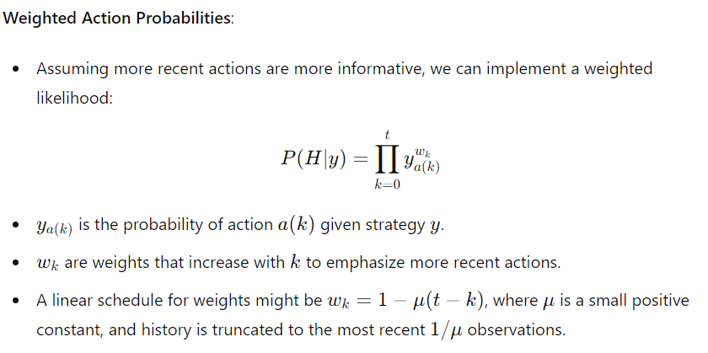
Bayesian strategy estimation

Slide 22
Exploration - Q Learning
Convergence Requirements in Q-Learning
Essential Condition: Must visit every state-action pair infinitely often to ensure convergence.
Implementation in Simulations:
Exploring Starts: Initiate training episodes from randomly selected state-action pairs to enhance state and action coverage.
Challenges in Real Environments
Off-Policy Randomized Exploration: Employ ε-greedy policies to ensure all actions in visited states are tried repeatedly.
Limitation: Does not guarantee that all states will be visited, unless the MDP is ergodic.
Impact: The Q-function learned may not perfectly match the optimal Q-function (Q*), but the difference in expected payoffs is typically small.

Slide 23
Exploration - Hyper Q
Application to Hyper-Q Learning
Exploring Starts for Mixed Strategies: Ensures comprehensive exploration of state-action spaces, including agent and opponent strategies.
ε-Greedy Exploration Without Starts:
Provides sufficient exploration of the agent's own strategy space.
Requires similar exploration by opponents to mirror traditional Q-learning effectiveness.
Effects of Non-Exploration by Opponents
Reduced State Space Exploration: If opponents do not explore, the effective state space that the Hyper-Q agent explores is reduced.
Long-term Payoff: Minimal impact expected on the agent’s long-term payoff even with reduced opponent exploration.
Both Q-learning and Hyper-Q learning strategies require comprehensive exploration to approximate the optimal policy effectively. Techniques like exploring starts and ε-greedy policies are crucial, especially when perfect state coverage is not feasible.

Slide 24
Experiments & Results

Slide 25
The agents we can play with
IGA (Infinitesimal Gradient Ascent)
PHC (Policy Hill-Climbing)
HyperQ - omniscient
HyperQ - EMA
HyperQ - Bayesian

Slide 26
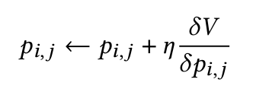
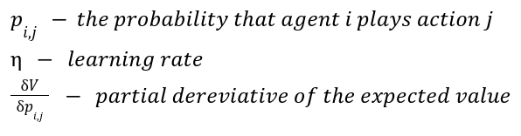
IGA (Infinitesimal Gradient Ascent)
Updates agent’s strategy in the direction of the gradient of the expected reward.
Requires knowledge of the other agent’s strategy at each time step.

Slide 27
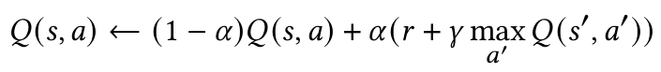
PHC (Policy Hill-Climbing)
Extends Q-learning to handle mixed strategies.
Updates both Q-values and the policy (strategy).
No knowledge of the other agent’s strategy or actions is required.
STEP 1 - standard Q-learning update

Slide 28
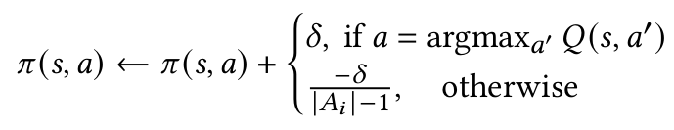
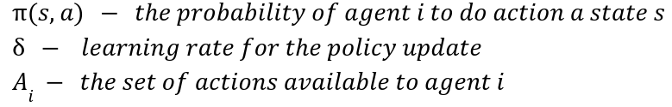
PHC (Policy Hill-Climbing)
STEP 2 - policy update:
Increase the probability of the action with the highest Q-value.
Decrease the probabilities of all other actions.

Slide 29
Bellman Online Error
The Bellman error acts as a “learning signal”, guiding the agent on how to update its Q-values to better approximate the true values.
A decreasing Bellman error over time indicates that the agent's Q-values are converging to the true Q-values.

Slide 30


The games
Rock-Paper-Scissors (Competitive)
Hill Climbing
(Cooperative)

Slide 31
The games
Rock-Paper-Scissors (Competitive)
 | rock1 | paper1 | scissors1
rock2 | 0 | -1 | 1
paper2 | 1 | 0 | -1
scissors2 | -1 | 1 | 0

Slide 32
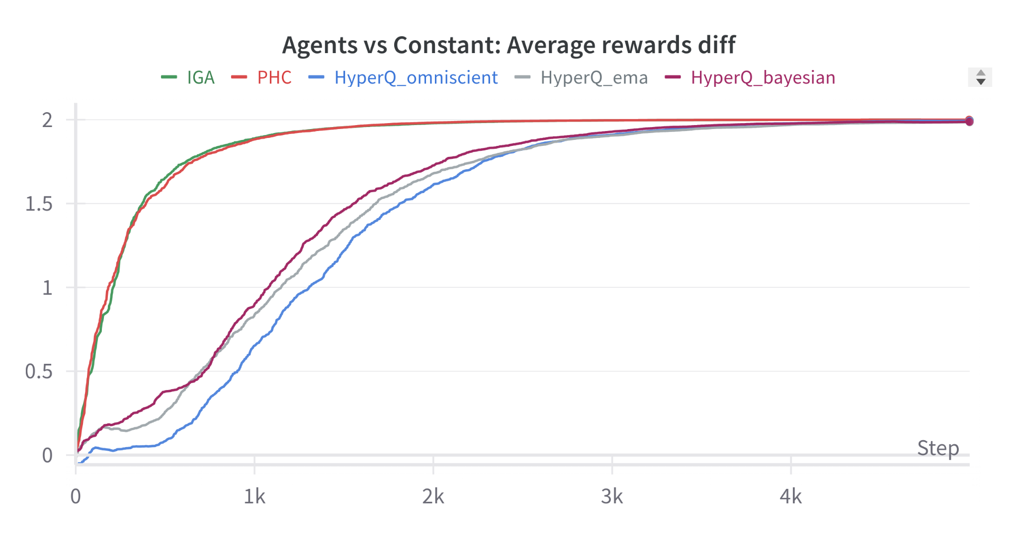
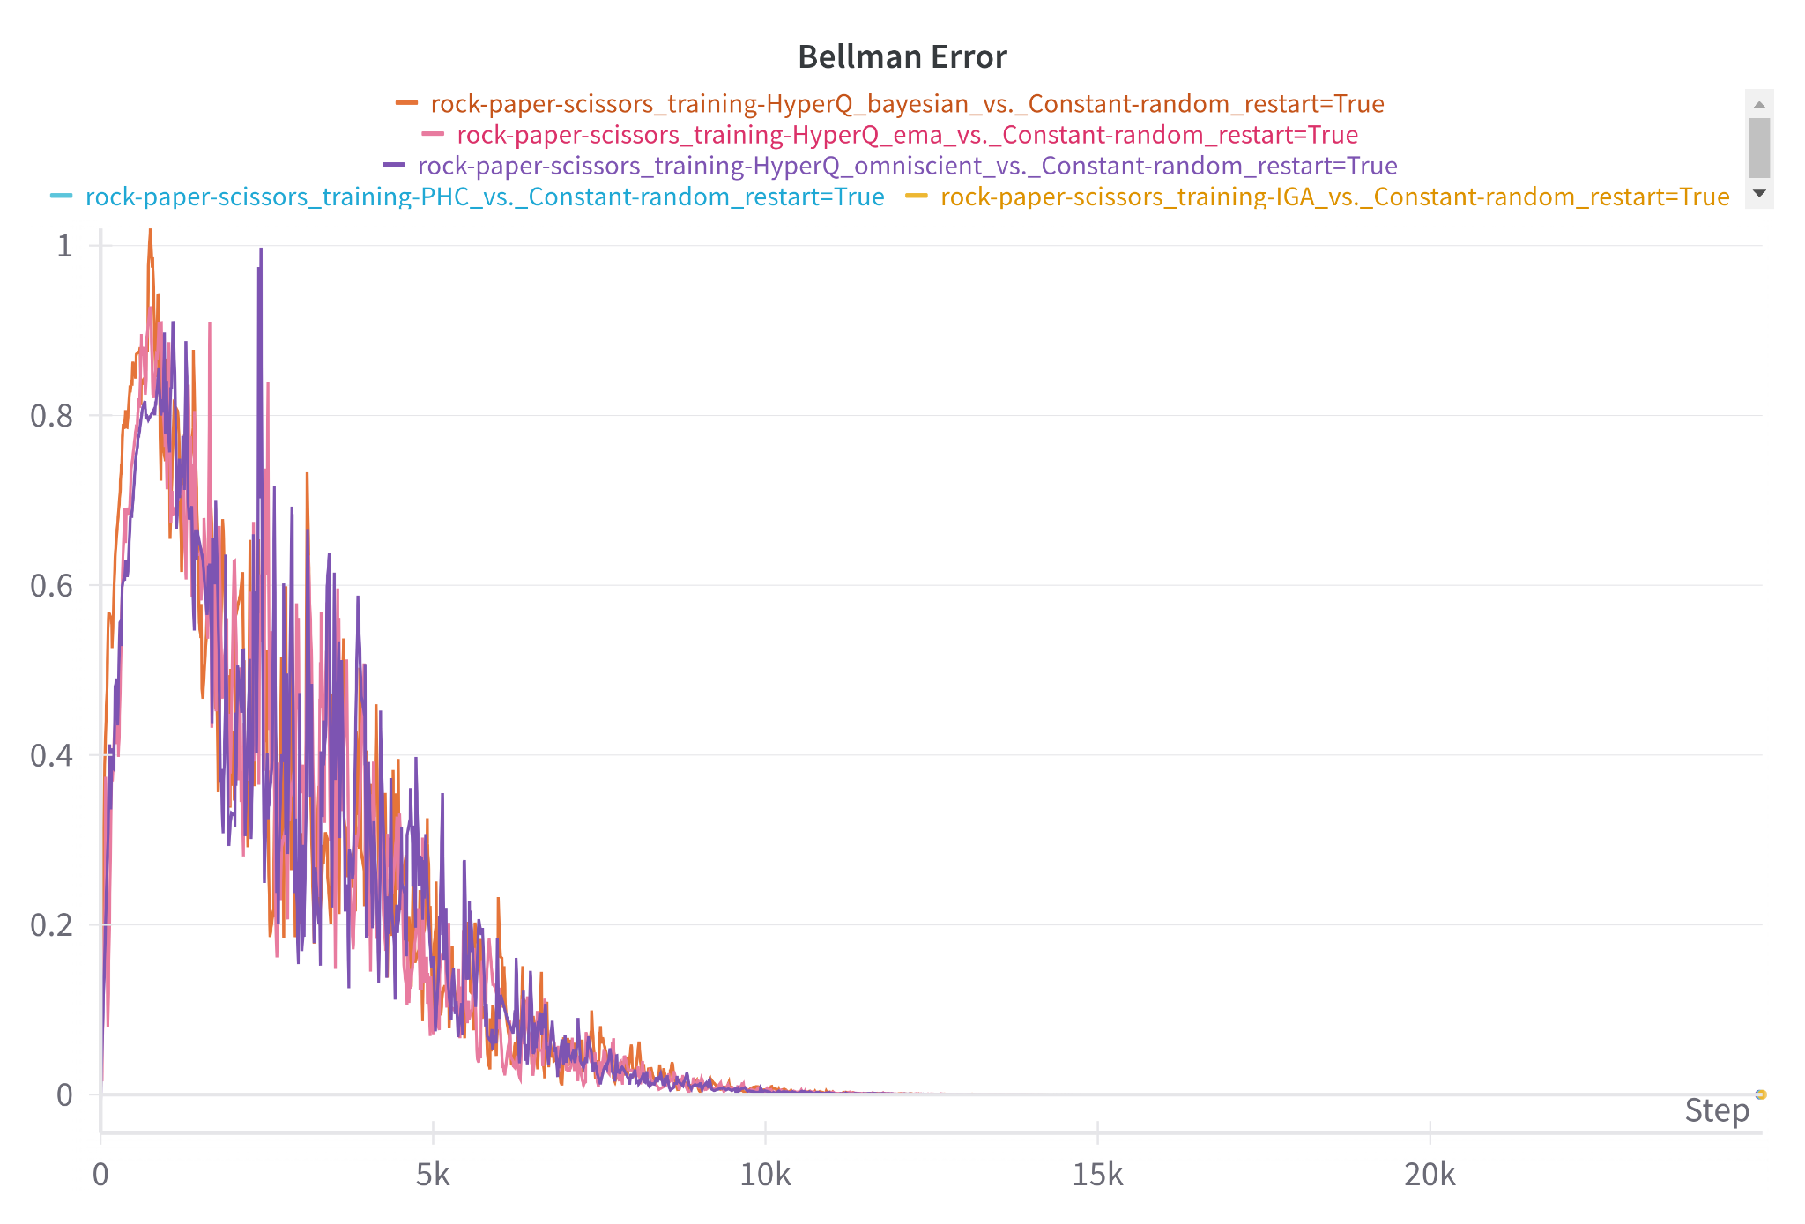
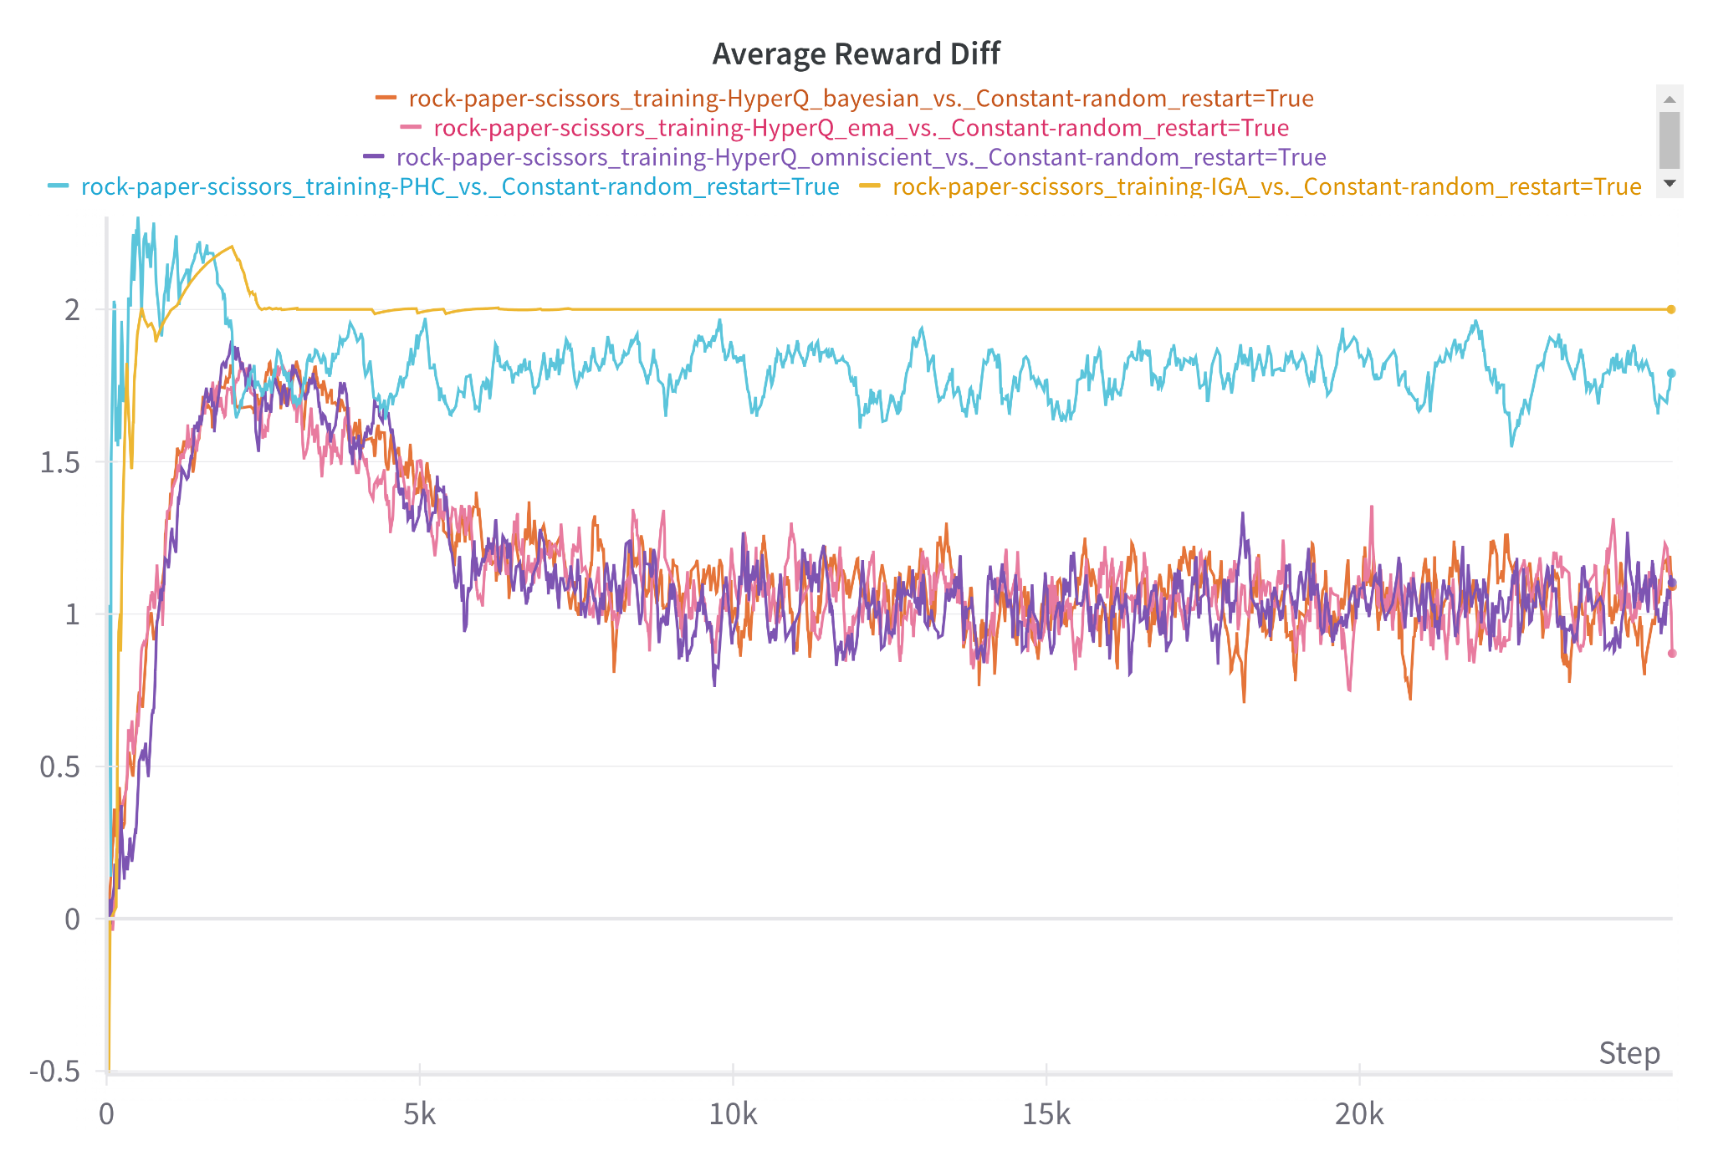
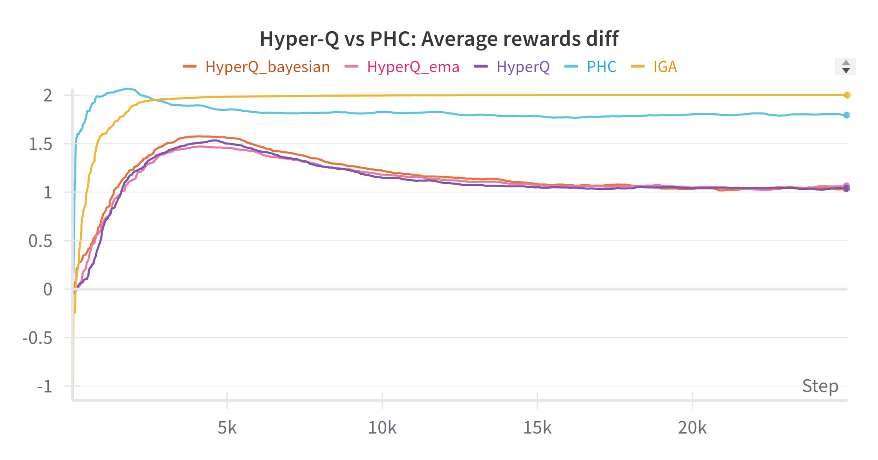
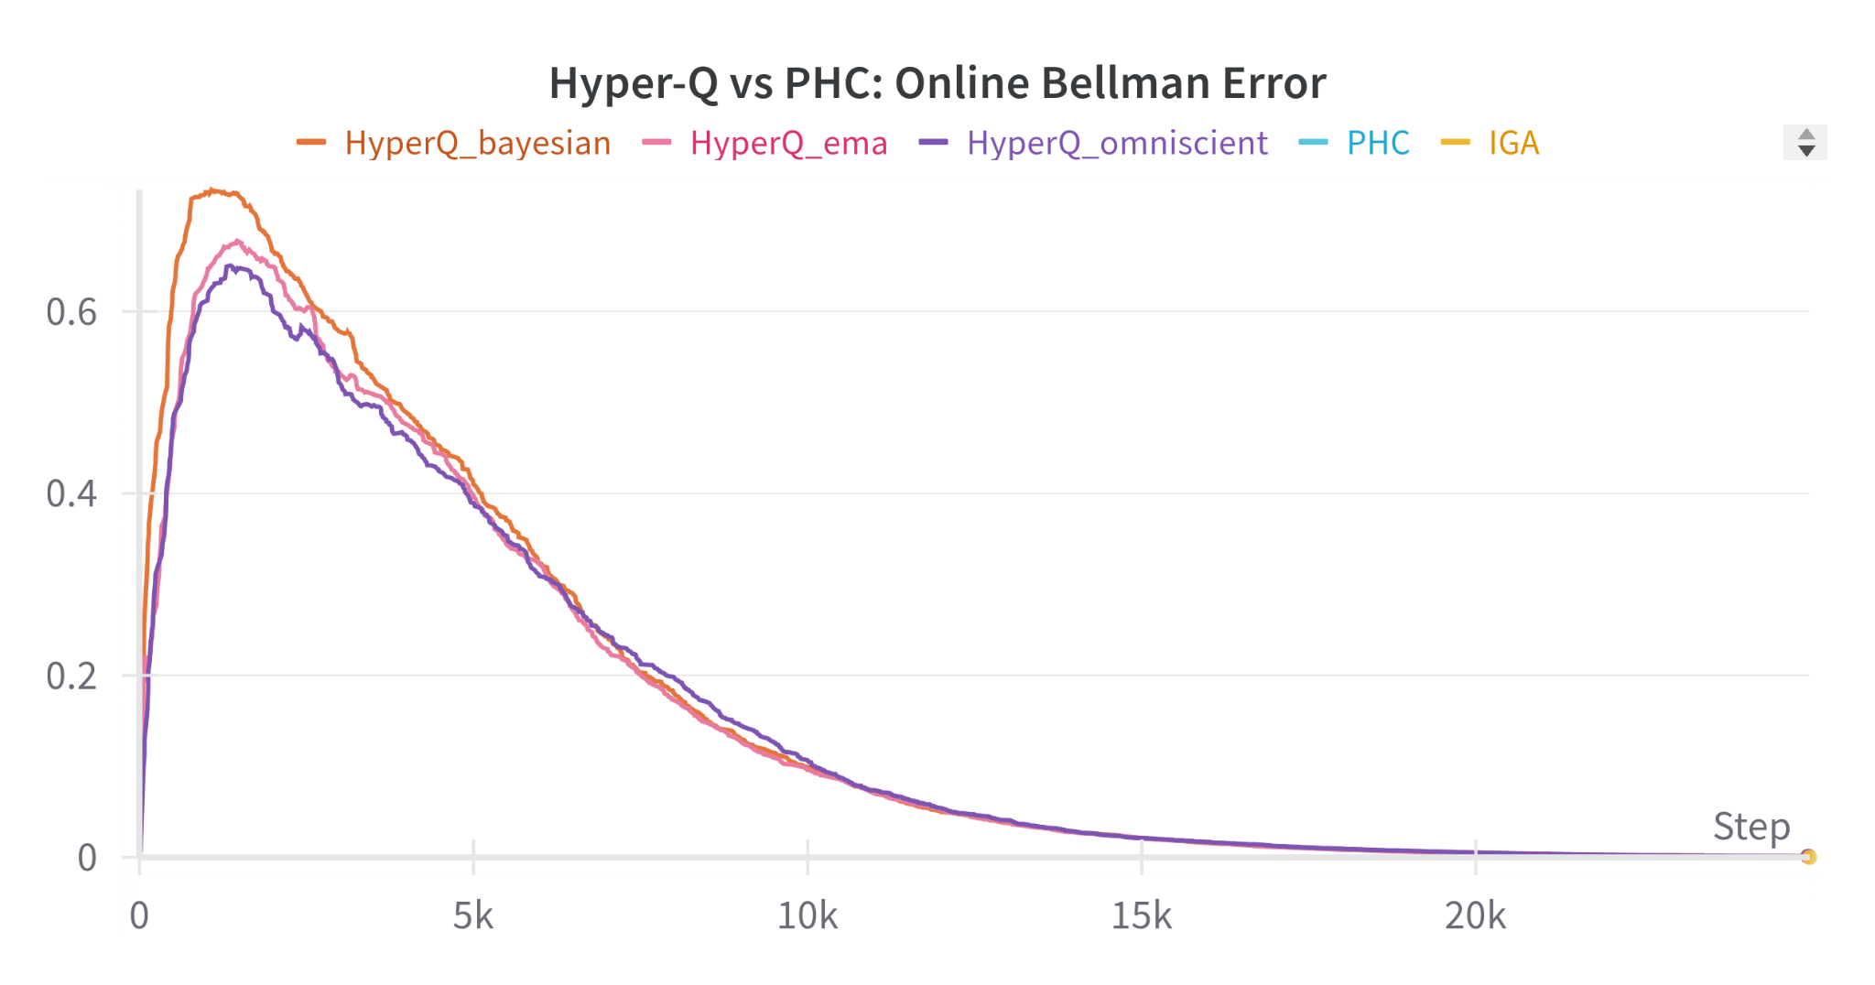
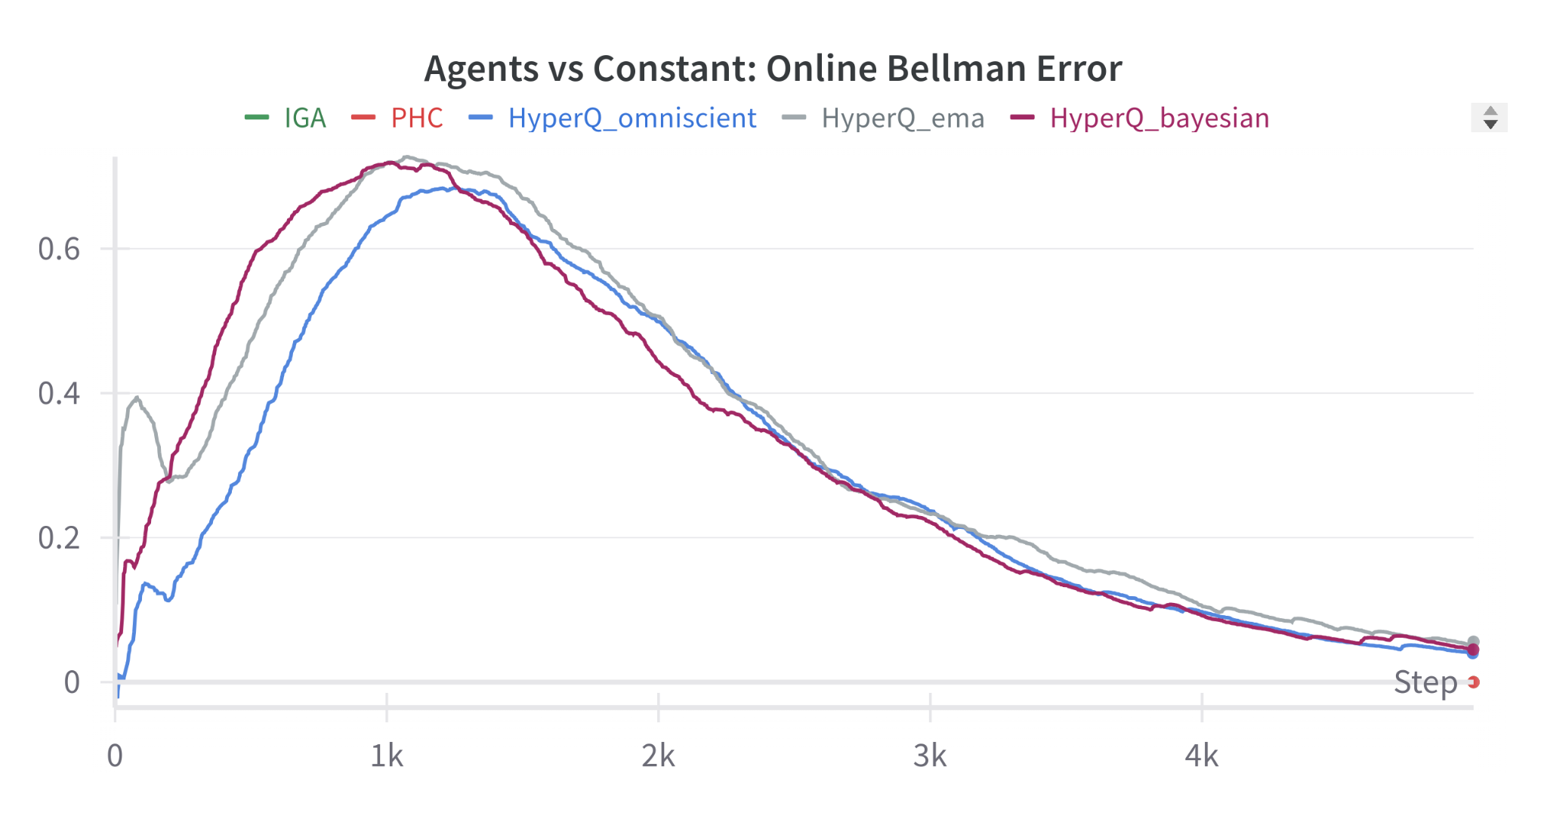
Play against constant Opponent

Slide 33
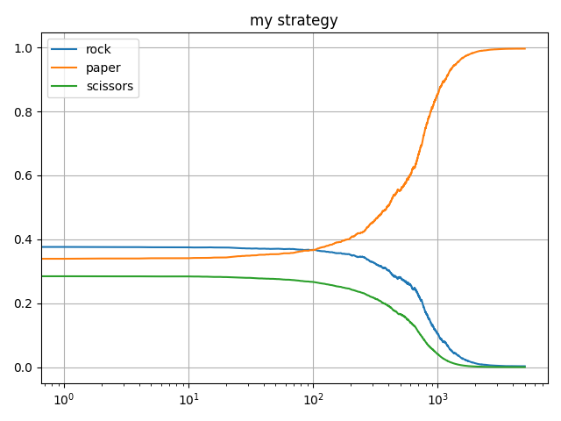
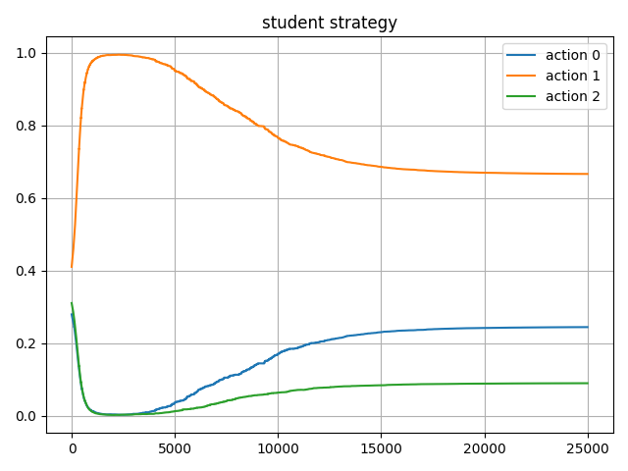
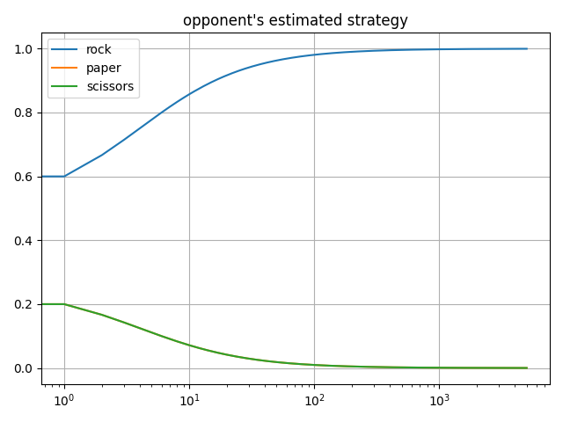
Play against constant strategy (HyperQ - Bayesian)

Slide 34
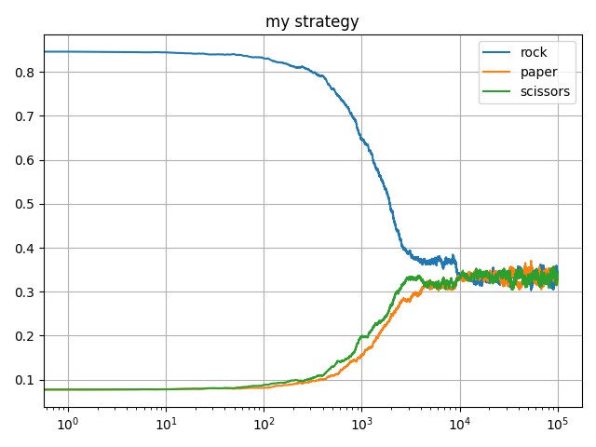
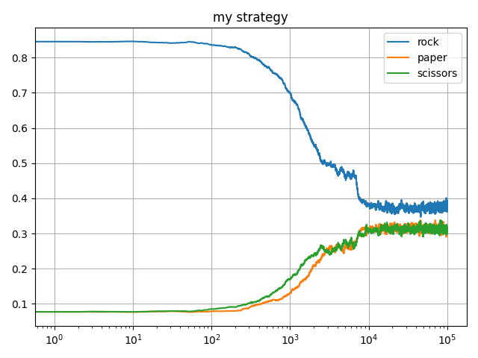
Play against random Opponent
Random Opponent’s strategy: [⅓, ⅓, ⅓ ]
To check our adaptive learning - we initialize our agent with strategy [1, 0, 0]
HyperQ - EMA
HyperQ - bayesian
probability

Slide 35
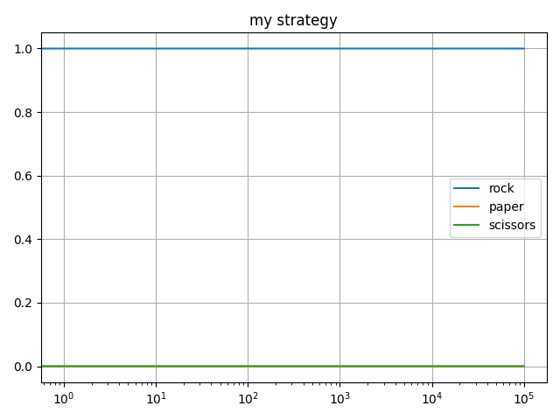
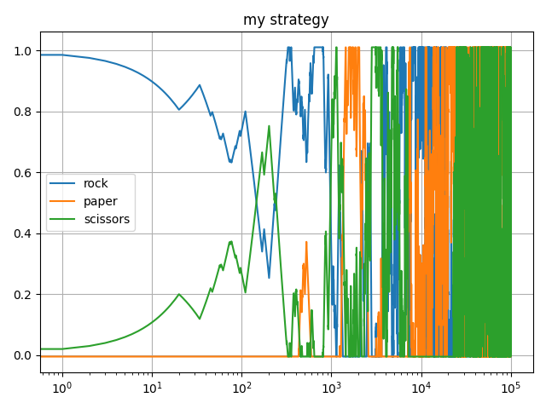
Play against random Opponent - Interesting results
IGA agent isn’t learning (zero gradients)
PHC agent isn’t converging to a strategy
IGA
PHC

Slide 36
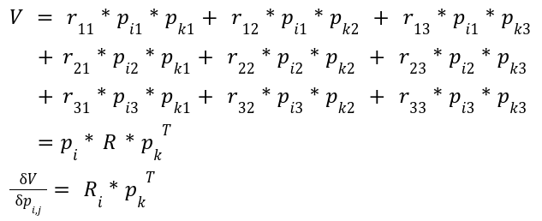
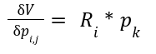
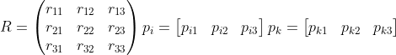
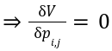
IGA (Infinitesimal Gradient Ascent)
We play zero-sum game -> sum(Ri)=0
Completely random opponent

Slide 37
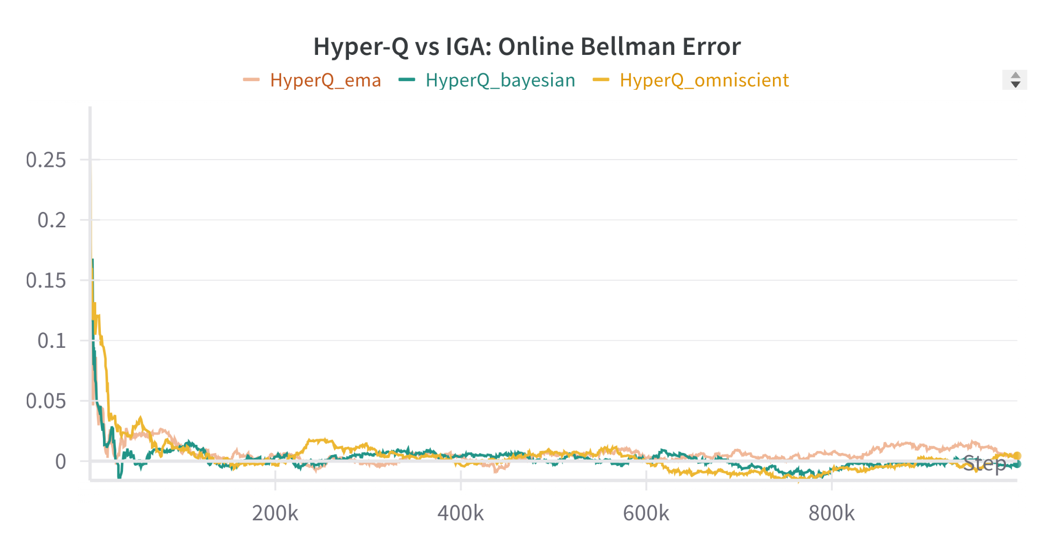
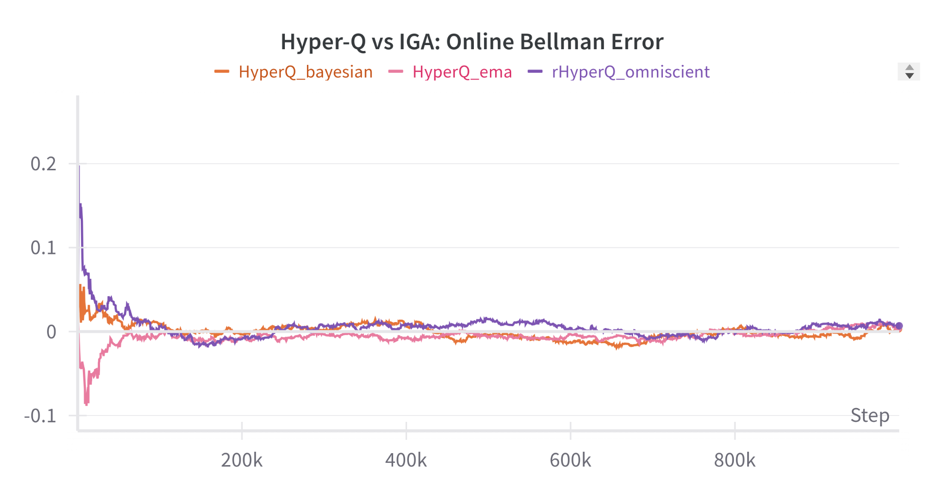
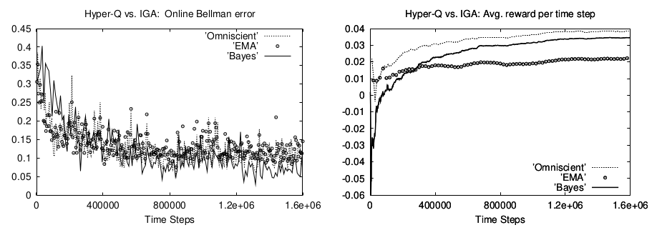
Hyper Q agent vs. IGA agent

Slide 38
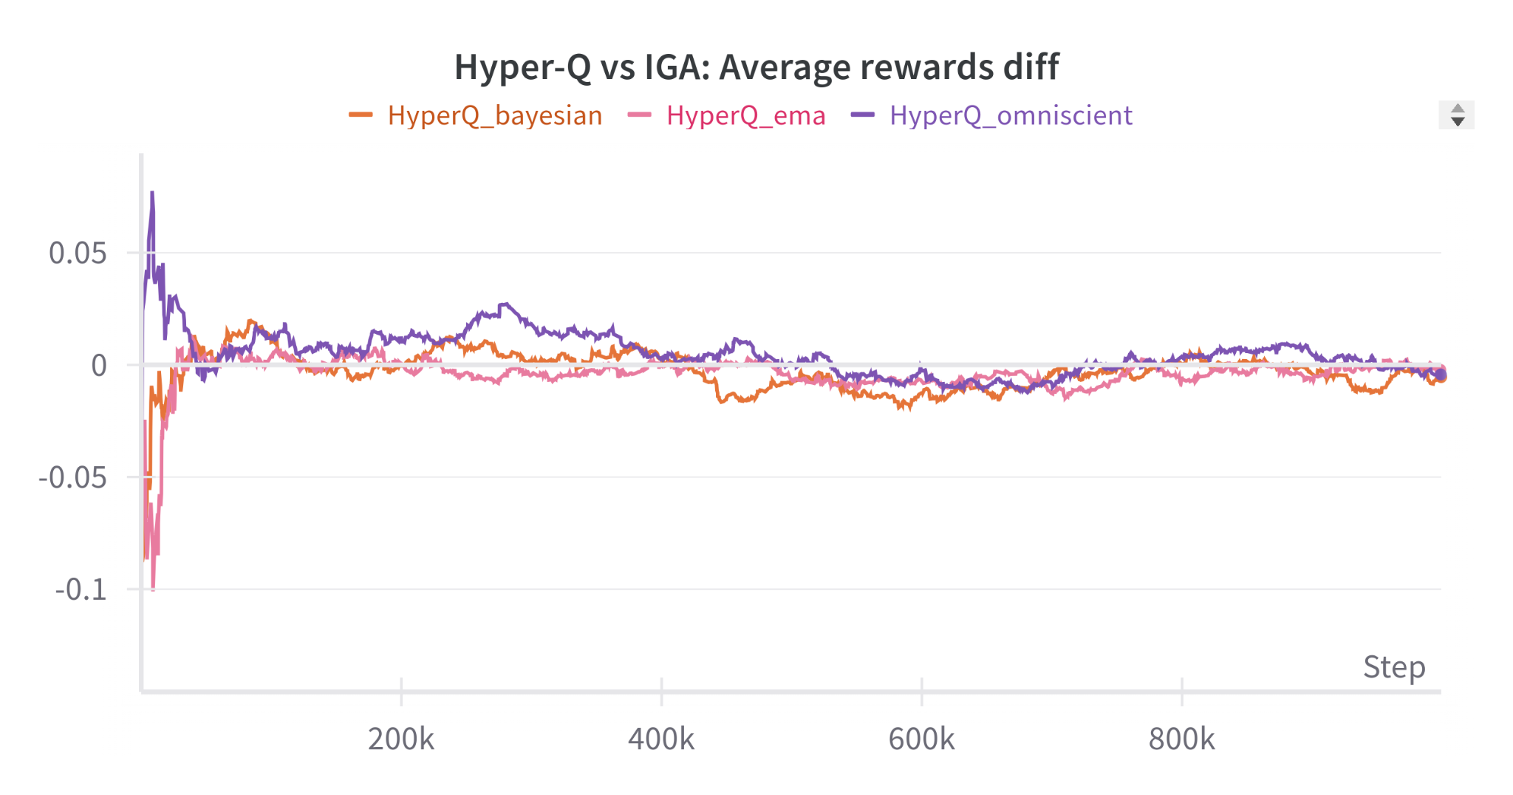
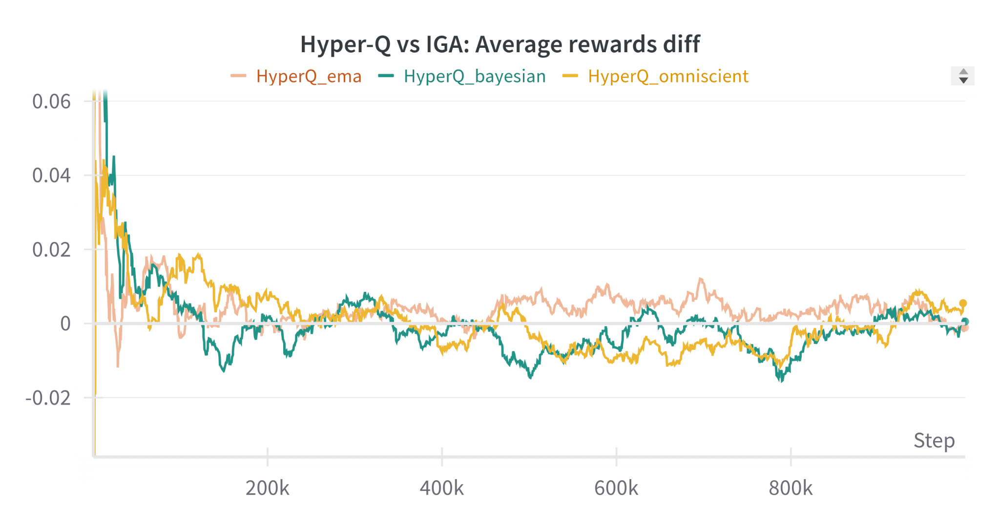
Hyper Q agent vs. IGA agent

Slide 39
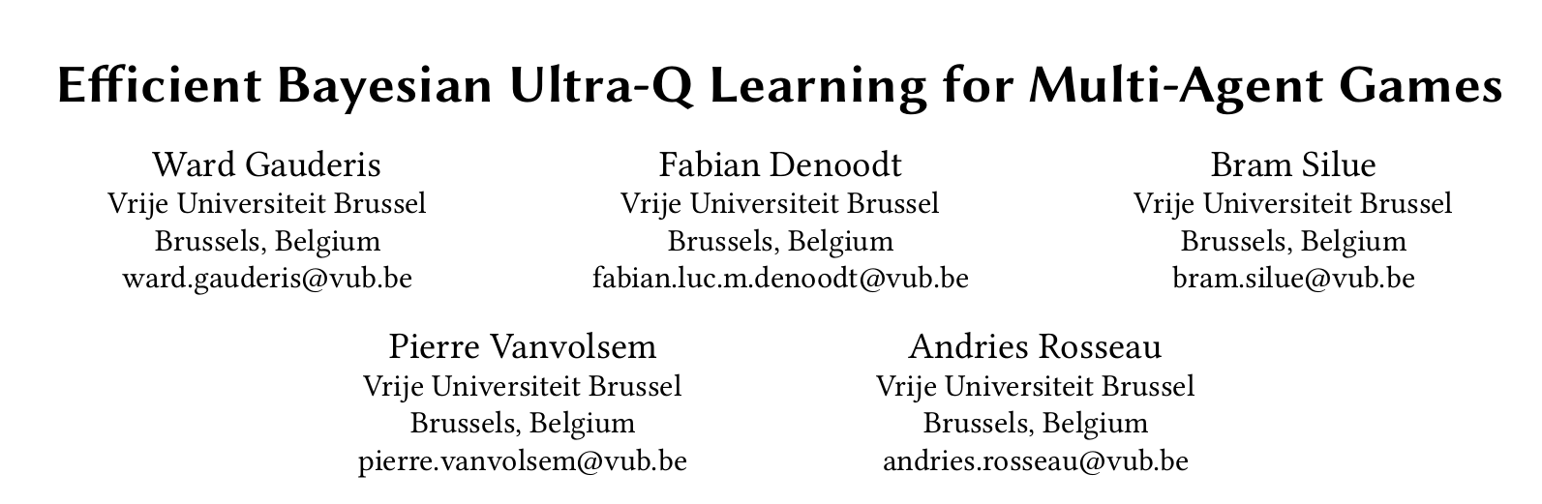
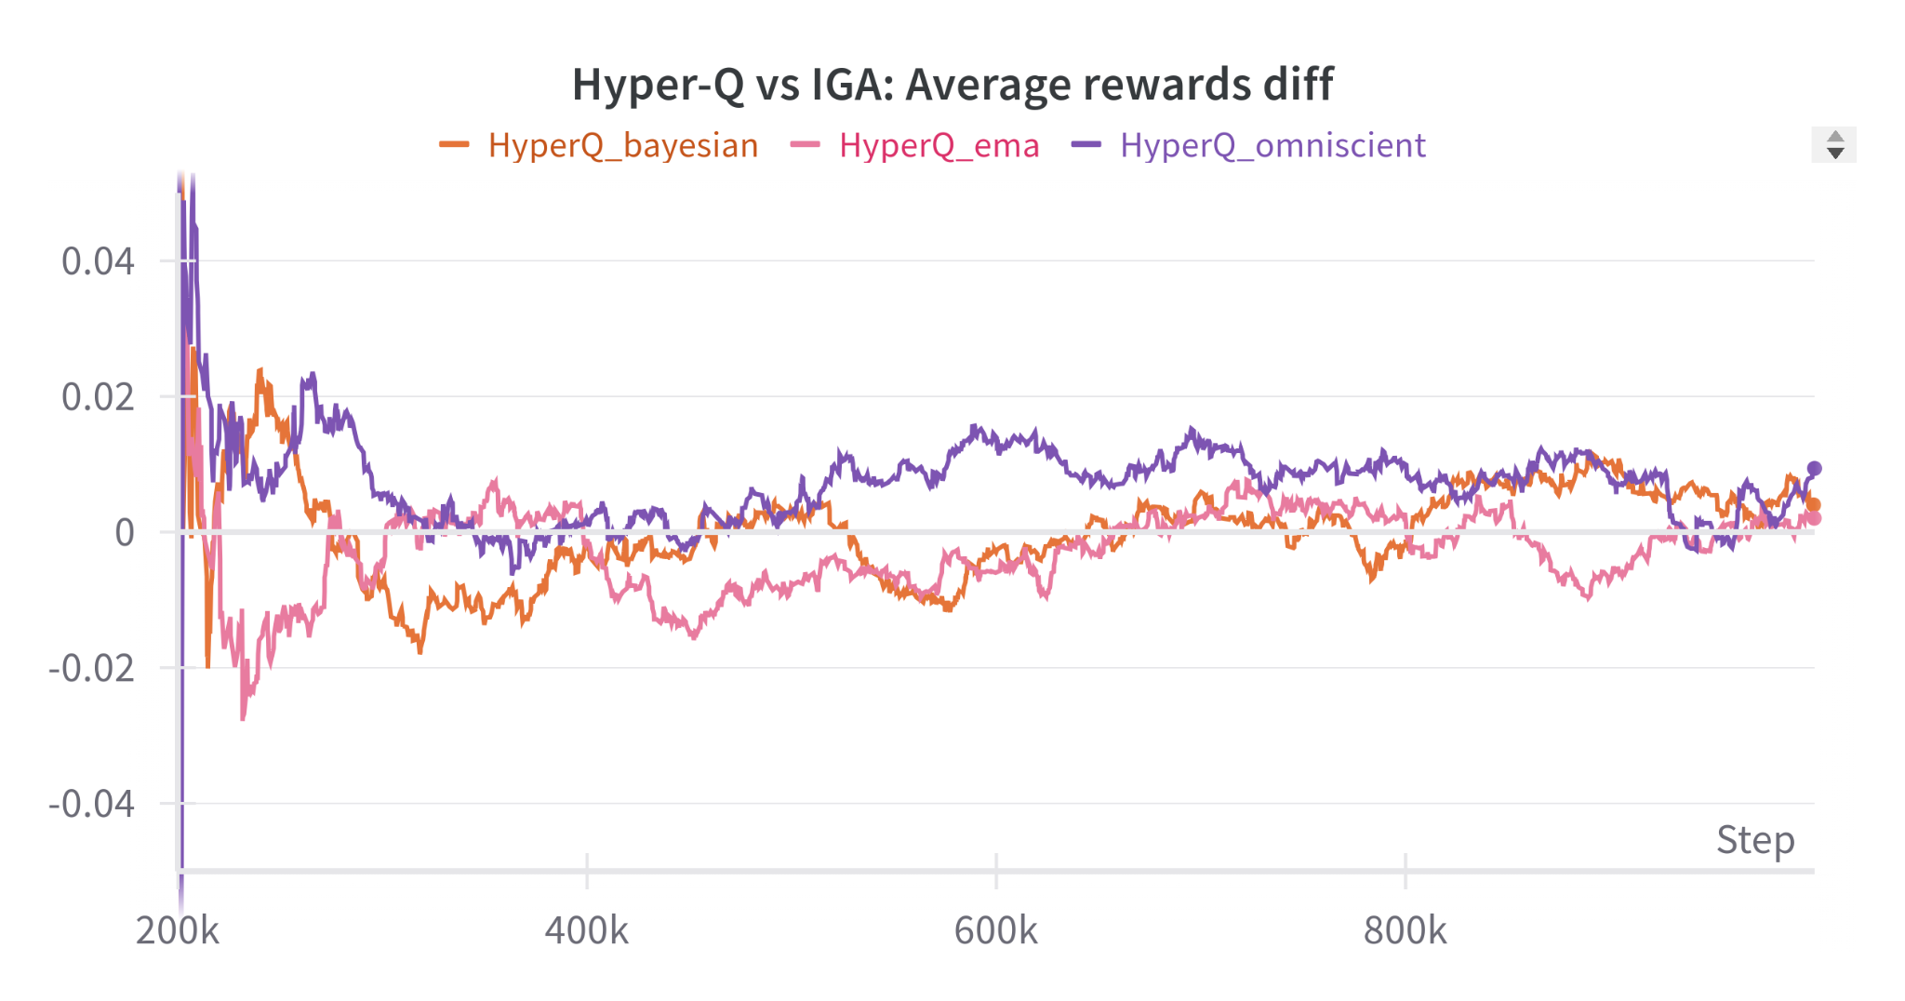
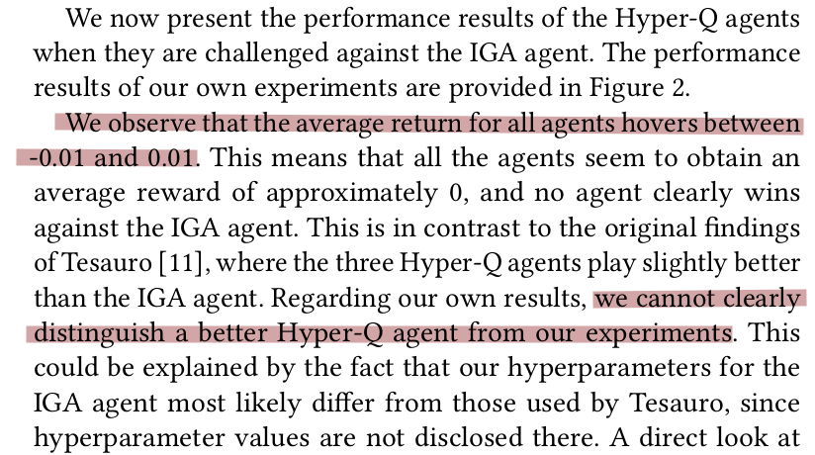
Hyper Q agent vs. IGA agent
Original results - Hyper-Q performs slightly better, without the need to know the opponent’s strategy.
In our results, no clear winning - low average rewards. the average return for all agents hovers between -0.01 and 0.01.
The omniscient agent is slightly better and have more winnings.

Slide 40
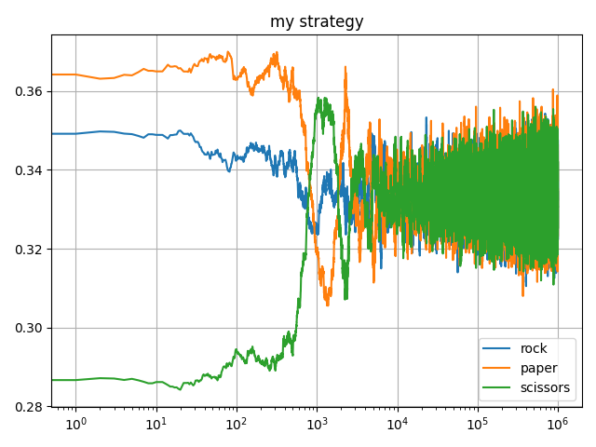
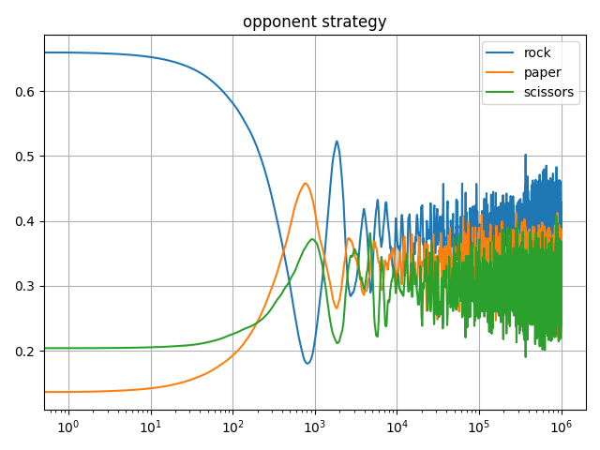
Hyper Q agent vs. IGA agent (HyperQ - Omniscient)

Slide 41
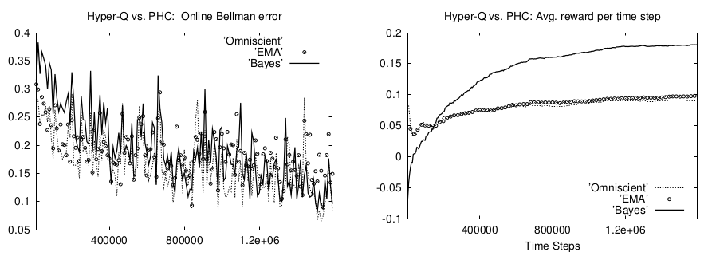
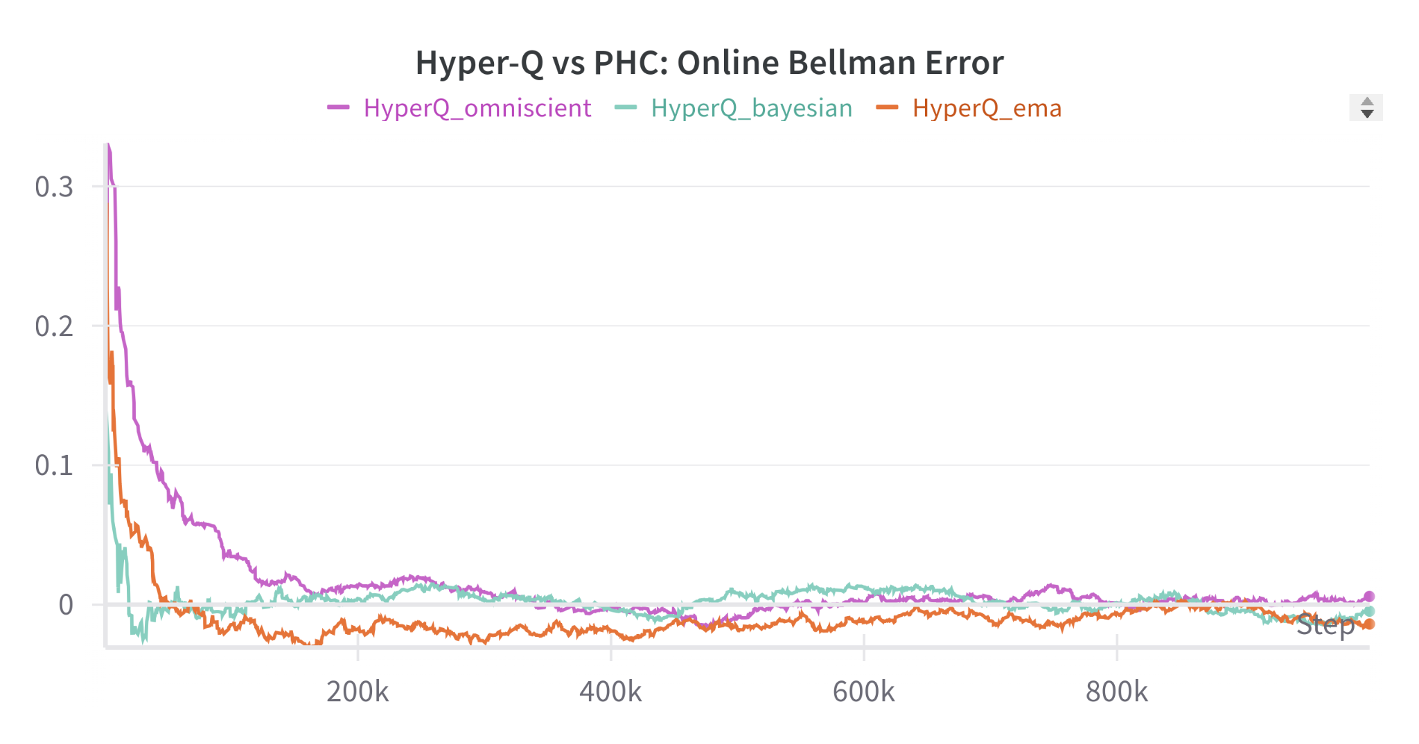
Hyper Q agent vs. PHC agent

Slide 42
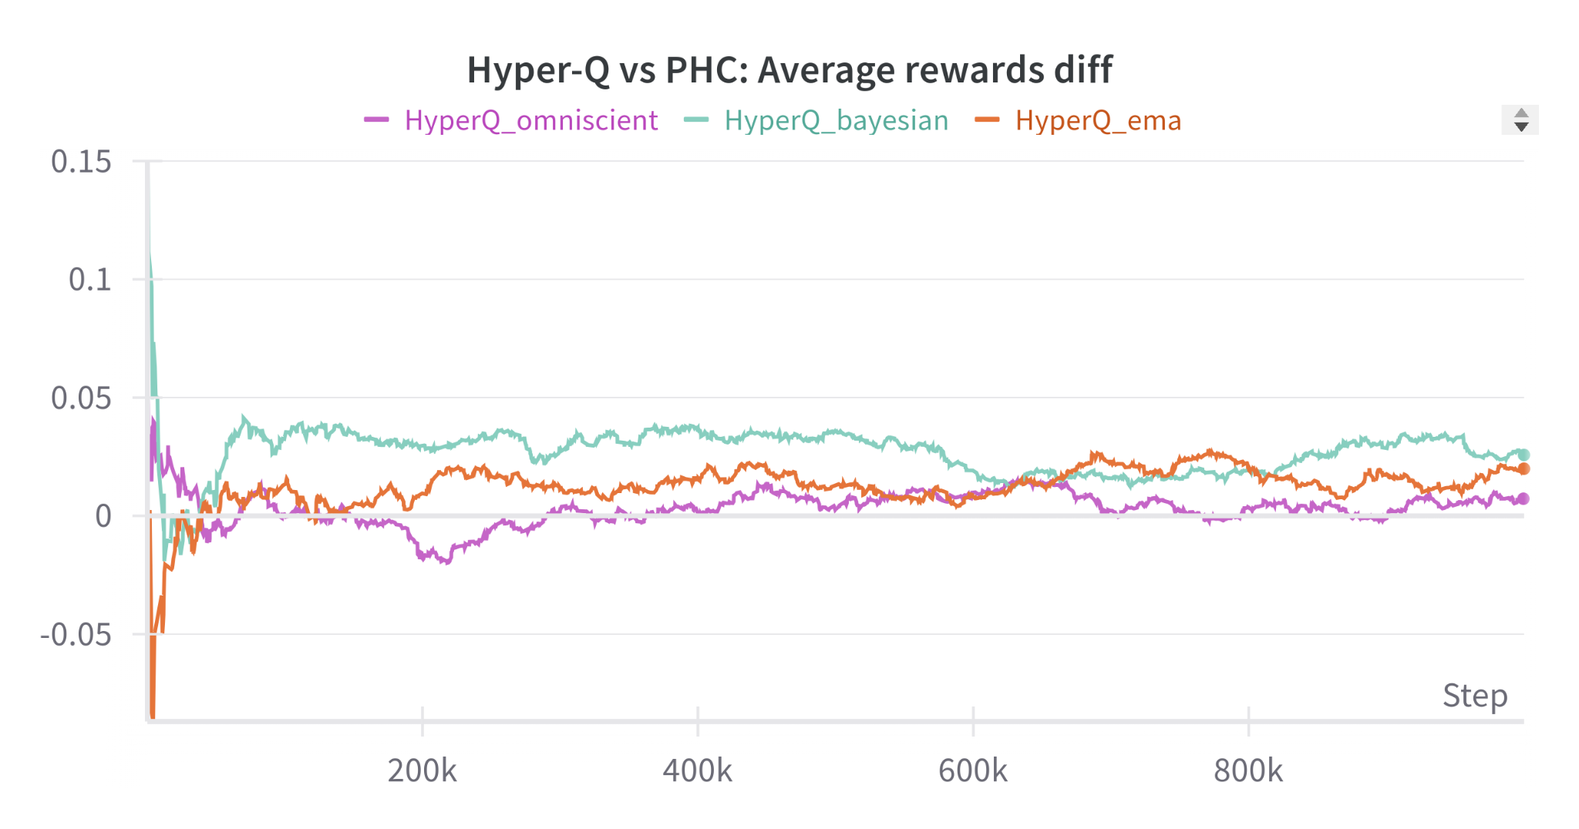
Hyper Q agent vs. PHC agent
Hyper-Q outperforms PHC.
‘Bayes’ method is better than ‘omniscient’ - a mystery.

Slide 43
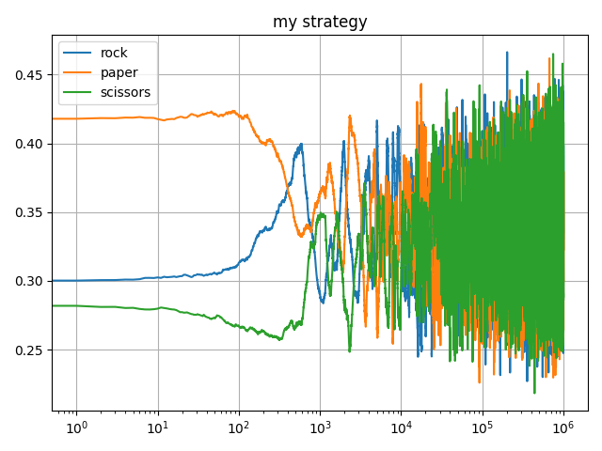
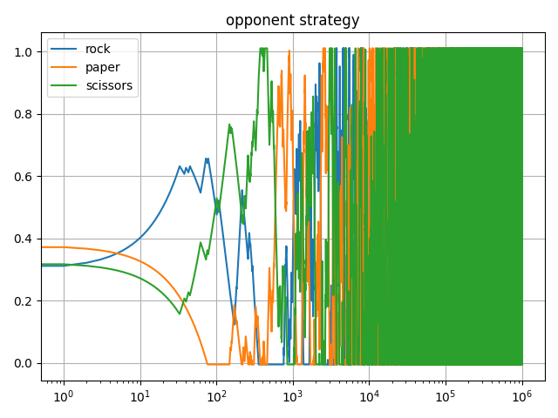
Hyper Q agent vs. PHC agent

Slide 44
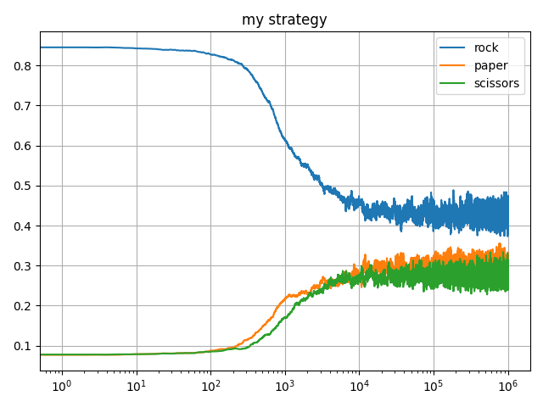
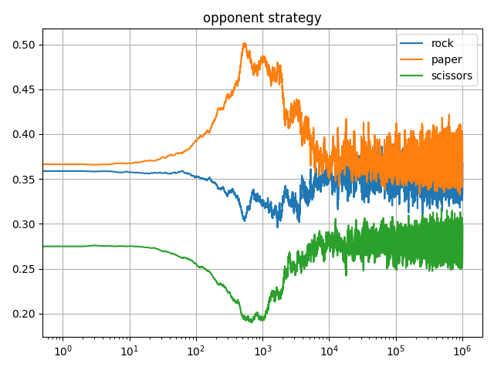
Hyper Q agent vs. Hyper Q agent

Slide 45

The games
Expected Reward = 0.4 X (-3.5) + 0.6 X 4 = 1
Hill Climbing
(Cooperative)
Expected Reward = 0.6 X (-6) + 0.4 X (-16) = -40
Expected Reward = 0.8 X (-6) + 0.2 X (-1) = -5
 | b0 | b1 | b2
a0 | 1 | -40 | -40
a1 | -40 | -3 | -4
a2 | -7.9 | -10 | -5

Slide 46


Play against (with) each other
Against Constant Opponent
Against an Equal Opponent

Slide 47

Play against (with) each other

Slide 48


Play against (with) each other (IGA)

